Slide 1


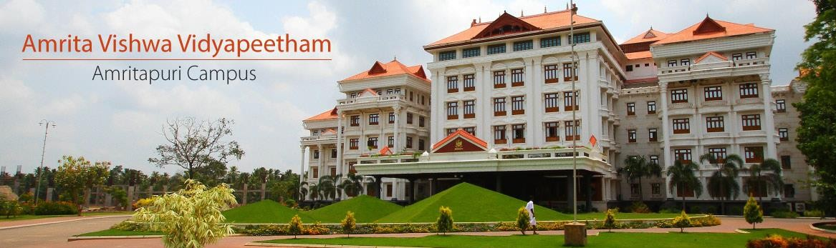
21AIE211 COMPUTER NETWORKS
2-0-3 3

Slide 2

Network Hardware

Slide 3
Types of Networks
Local Area Networks
Metropolitan Area Networks
Wide Area Networks
Wireless Networks
Home Networks
There are many different types of network, which can be used for different purposes and by different types of
people and organization. Here are some of the networks
32

Slide 4
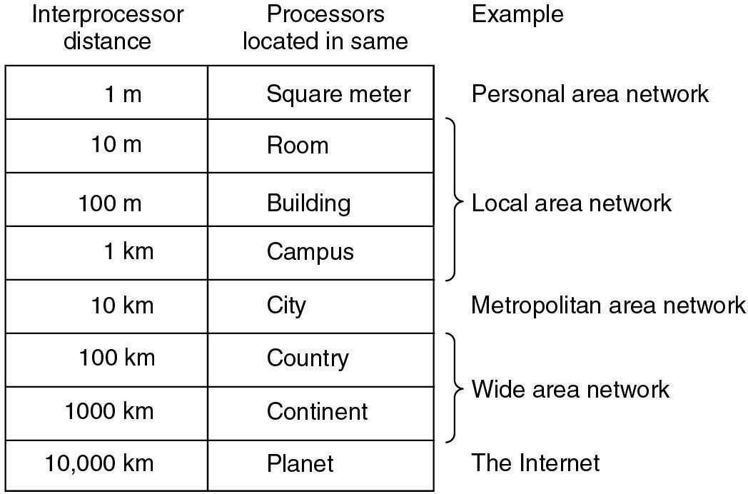
Classification of interconnected processors by scale

Slide 5
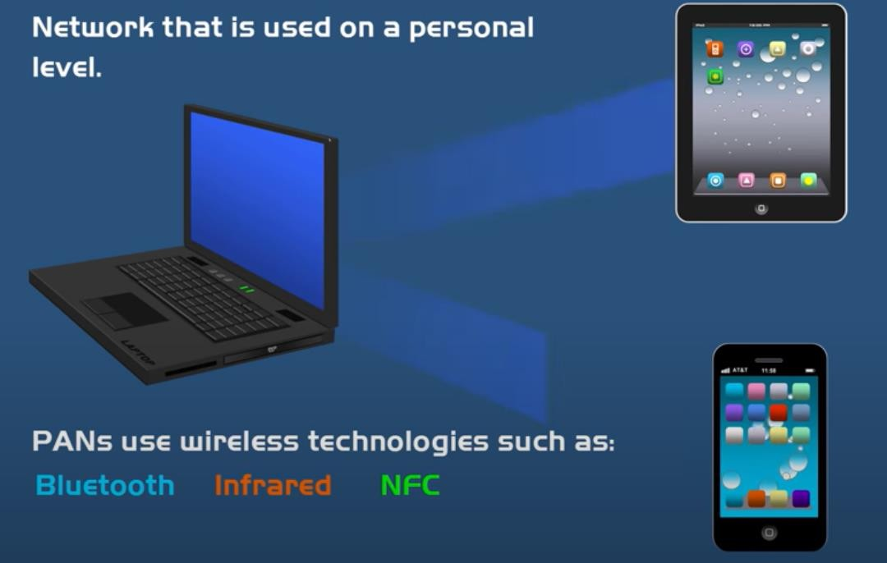
Personal Area Network ( PAN)

Slide 6
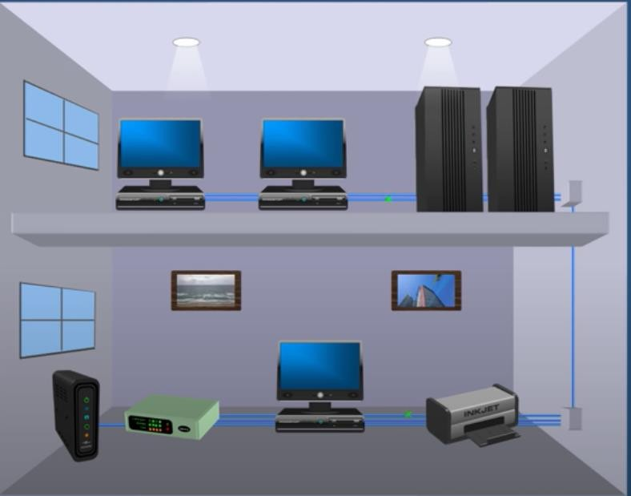
Local Area Networks (LANs)
Group of devices (computers servers, printers , switches etc located in the same building
In close proximity to each other
Most common type of LAN is ethernet LAN
Courtesy: powerCert Animation Videos

Slide 7
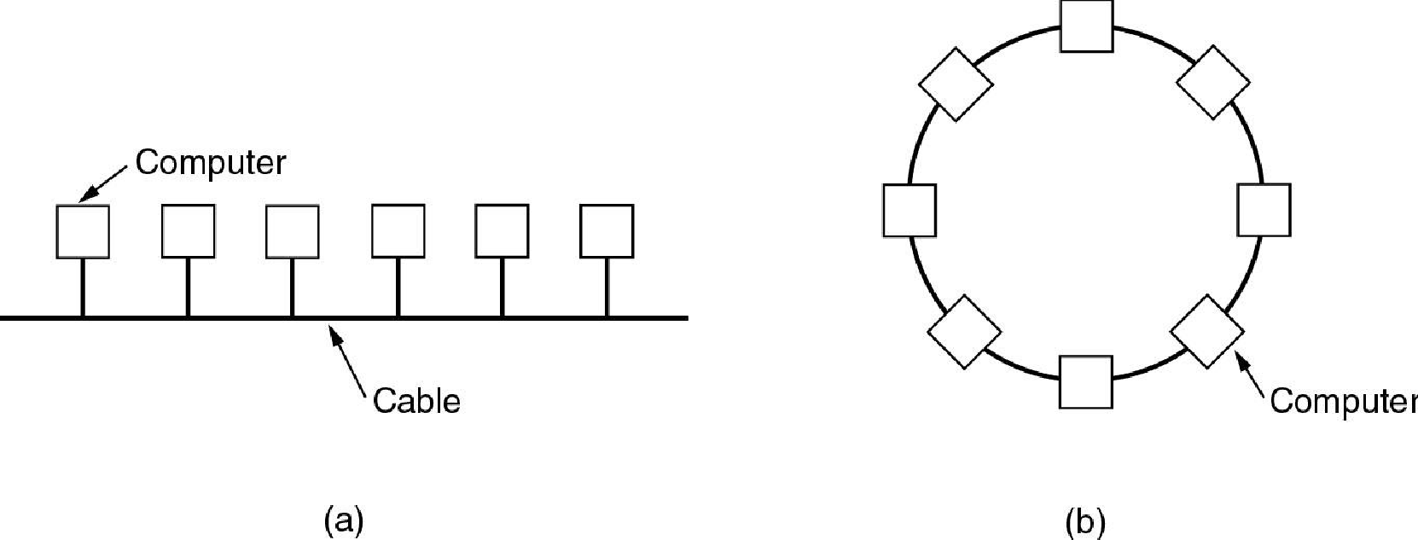
Local Area Networks (LANs)
A local area network or LAN is a network that connects computers within a limited area. This might be in a
school, an office or even a home.
Characterics of LANs: (a) privated-owned, (b) small size,
(c) transmission technology, (d) topology
Ethernets are most popular (up to 10 Gb/s)
Two broadcast networks
(a) Bus
(b) Ring
36

Slide 8
Local Area Networks
Characteristics
small size
transmission technology
single cable
10Mbps ~ 10Gb/s
topology:
bus
Ethernet (IEEE 802.3): 10 or 100 Mbps (10Gb/s)
ring
IBM token ring (IEEE 802.5): 4 or 16 Mbps
Channel allocation of broadcast networks ^{IEEE 802 is a collection}
of networking standards that cover the physical and data-link layer specifications for
static: each machine has an allocated time slot
dynamic
technologies such as Ethernet and wireless
37

Slide 9
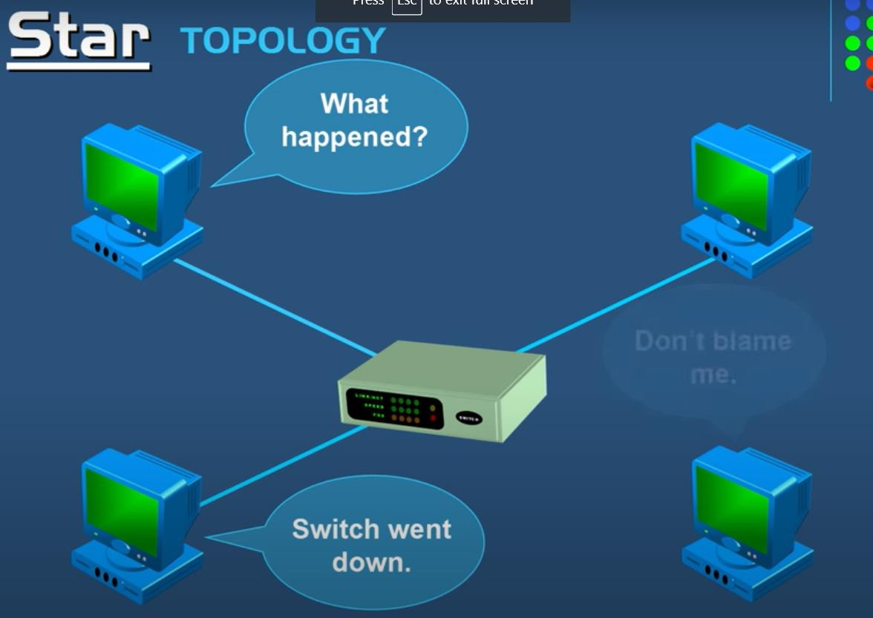
Network Topologies- STAR
Pros
If N devices are connected to each other in star topology, then the number of cables required to connect them is N. So, it is easy to set up.
Each device require only 1 port i.e. to connect to the hub.
Cons
If the concentrator (hub) on which the whole topology relies fails, the whole system will crash down.
Cost of installation is high.
Performance is based on the single concentrator i.e. hub.
Courtesy: powerCert Animation Videos

Slide 10
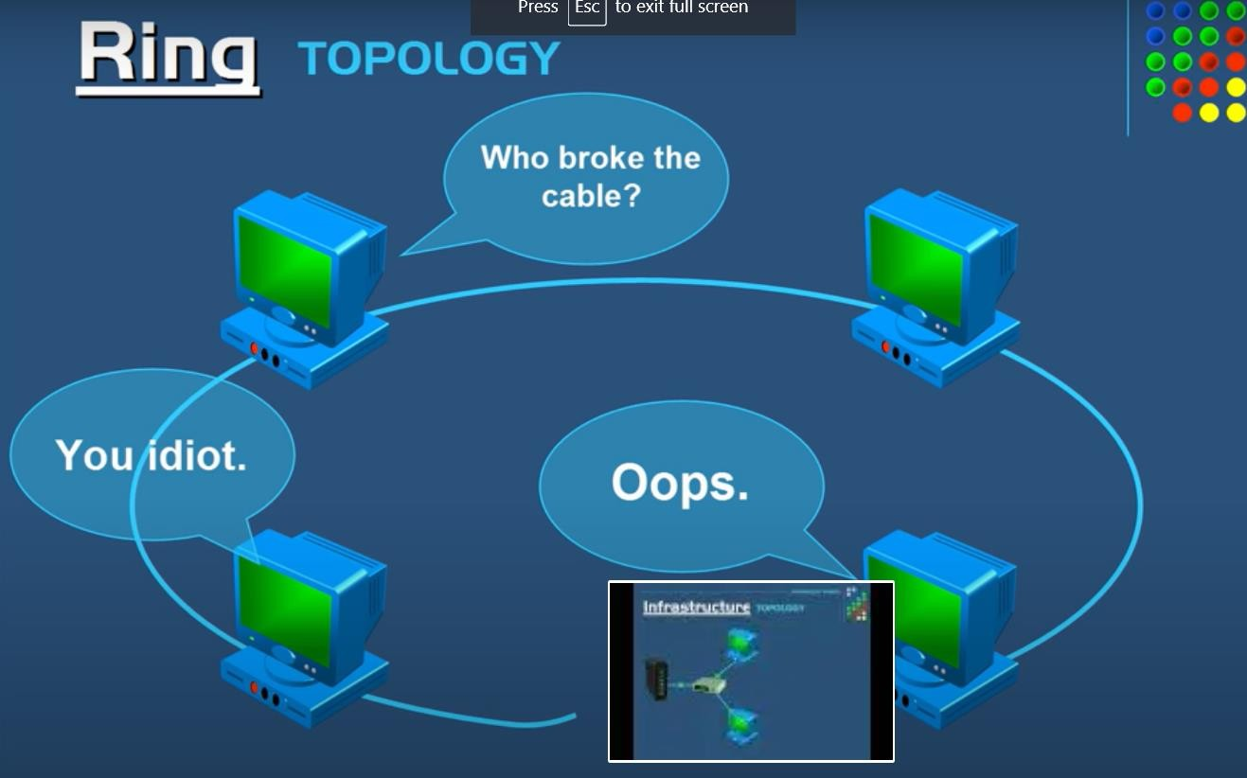
Network Topologies- RING
Advantages of this topology :
All data flows in one direction, reducing the chance of packet collisions.
A network server is not needed to control network connectivity between each workstation.
Data can transfer between workstations at high speeds.
Cheap to install and expand.
Problems with this topology :
If one computer goes wrong all will
go wrong
Troubleshooting is difficult in this topology.
Addition of stations in between or removal of stations can disturb the whole topology.
Courtesy: powerCert Animation Videos

Slide 11
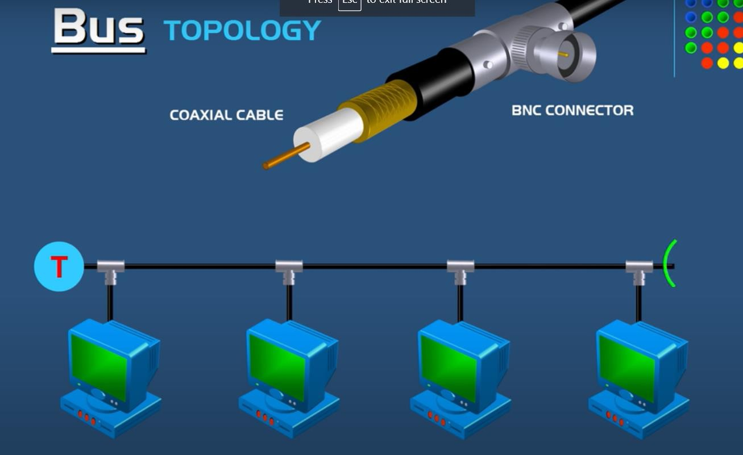
Network Topologies- BUS
Advantages of this topology :
If N devices are connected to each other in bus topology, then the number of cables required to connect them is 1 ?which is known as backbone cable and N drop lines are required.
Cost of the cable is less as compared to other topology, but it is used to built small networks.
Problems with this topology :
If the common cable fails, then the whole system will crash down.
If the network traffic is heavy, it increases
collisions in the network..
Terminator gets open data flow disrupted
Courtesy: powerCert Animation Videos

Slide 12
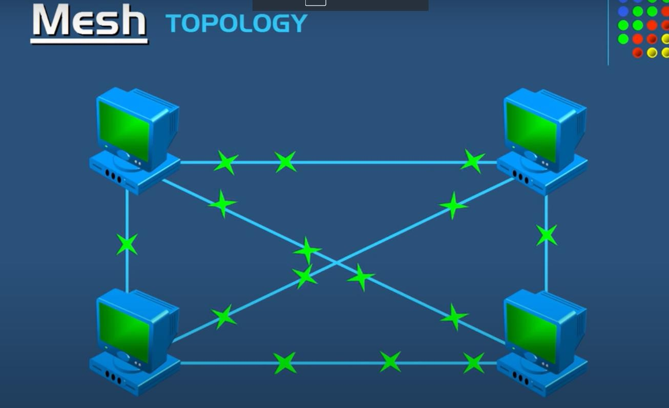
Network Topologies- MESH
Advantages of a mesh topology
Manages high amounts of traffic, because multiple devices can transmit data simultaneously.
A failure of one device does not cause a break in the network or transmission of data.
Adding additional devices does not disrupt data transmission between other devices. Disadvantages of a mesh topology
The cost to implement is higher than other network topologies, making it a less desirable option.
Building and maintaining the topology is difficult and time consuming.
The chance of redundant connections is high, which adds to the high costs and potential for reduced efficiency.
Courtesy: powerCert Animation Videos

Slide 13
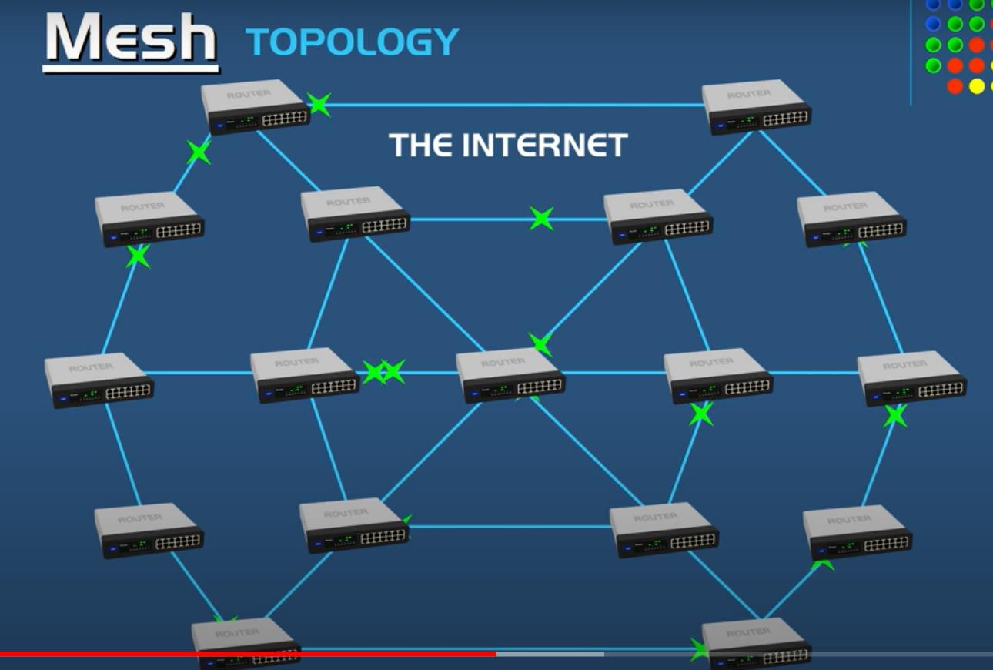
Courtesy: powerCert Animation Videos

Slide 14
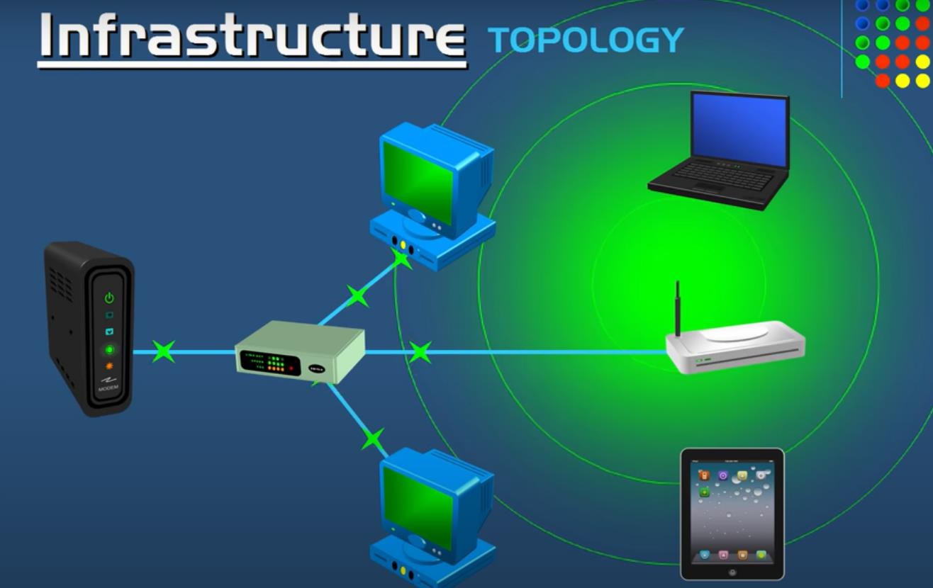
Wireless Topologies

Slide 15
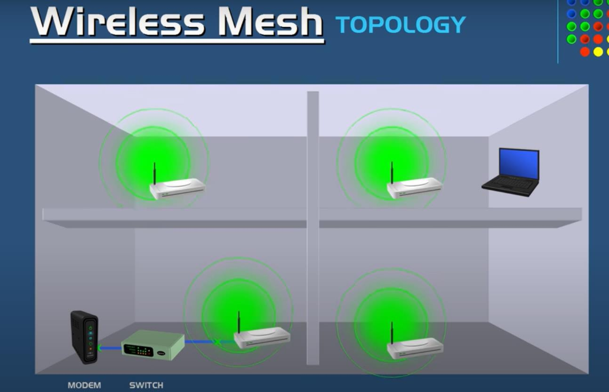
Wireless Topologies
Courtesy: powerCert Animation Videos

Slide 16
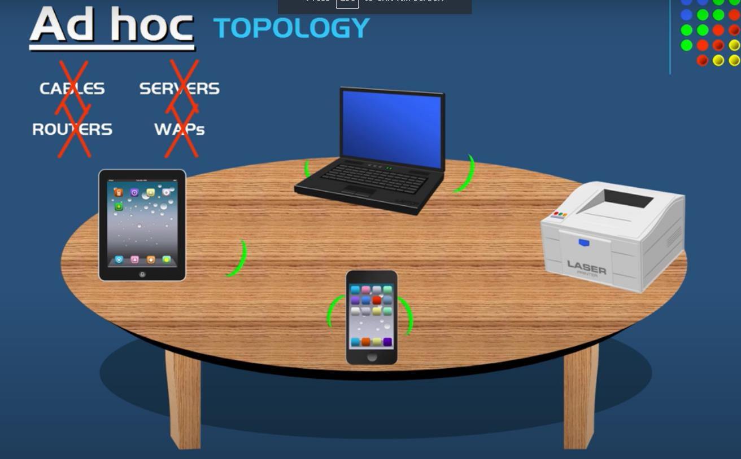
Courtesy: powerCert Animation Videos

Slide 17
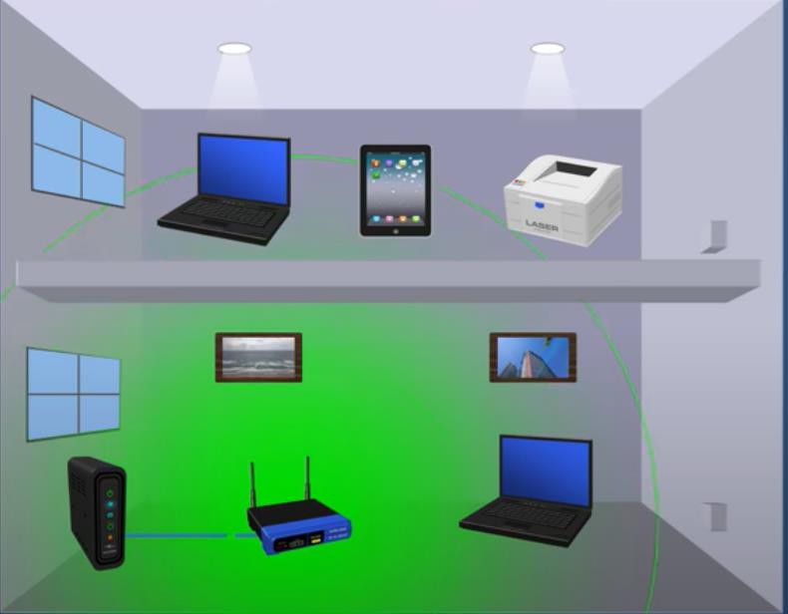
Wireless LAN
Use wireless connection instead of wired
Courtesy: powerCert Animation Videos

Slide 18
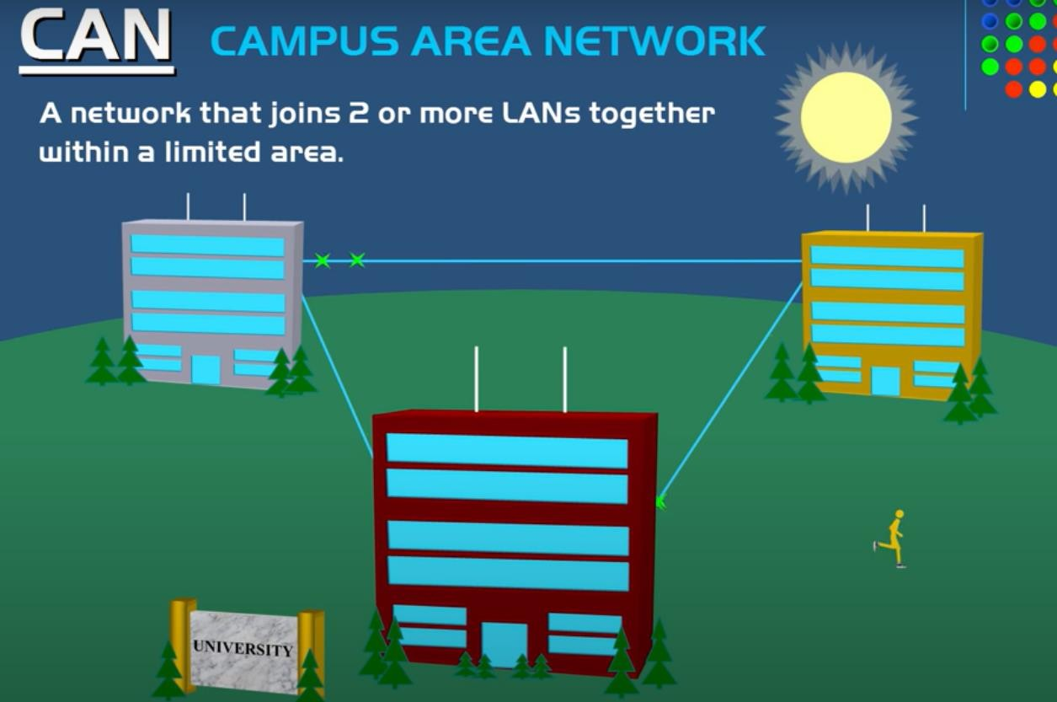

Slide 19
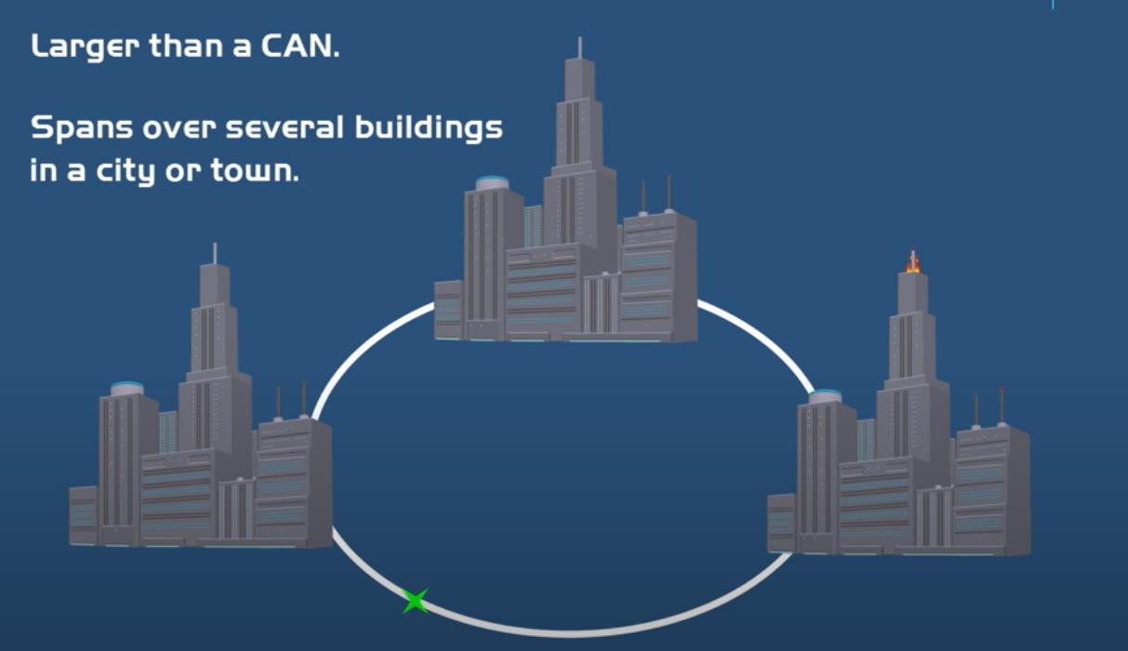
MAN ( Metropolitan Area Network)
Courtesy: powerCert Animation Videos

Slide 20
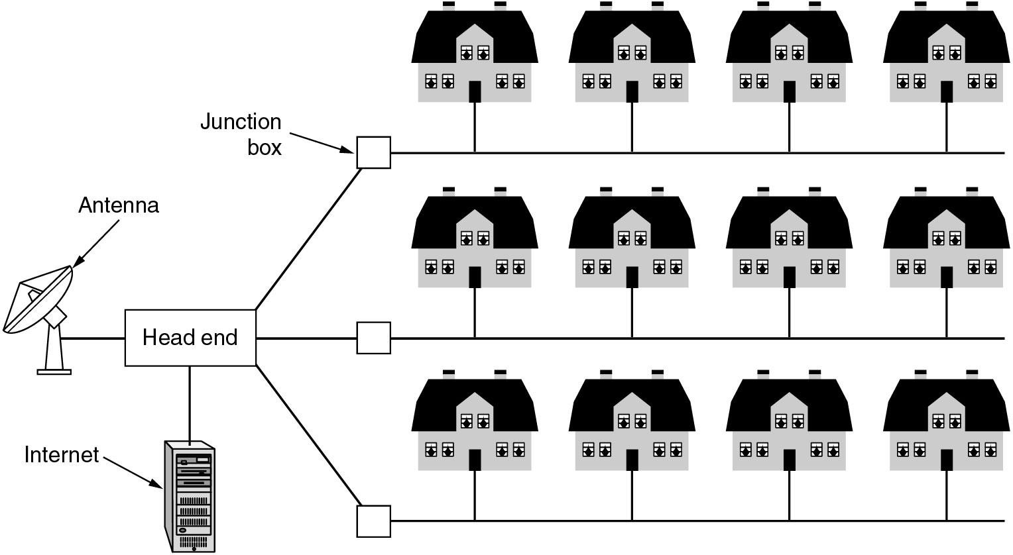
Metropolitan Area Networks
A metropolitan area network based on cable TV.
49

Slide 21
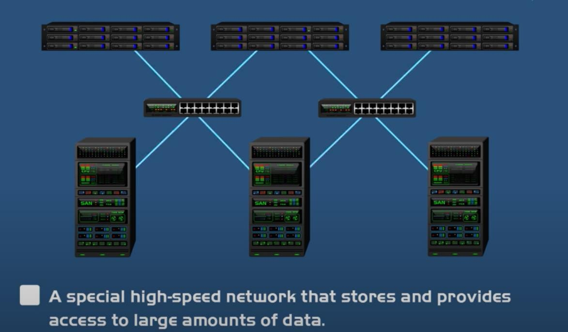
SAN ( Storage Area Network)

Slide 22
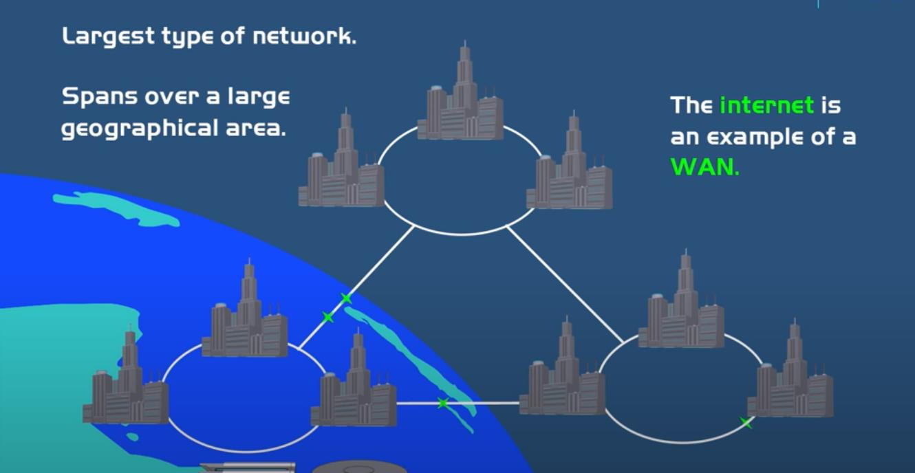
WAN( Wide Area Network)

Slide 23
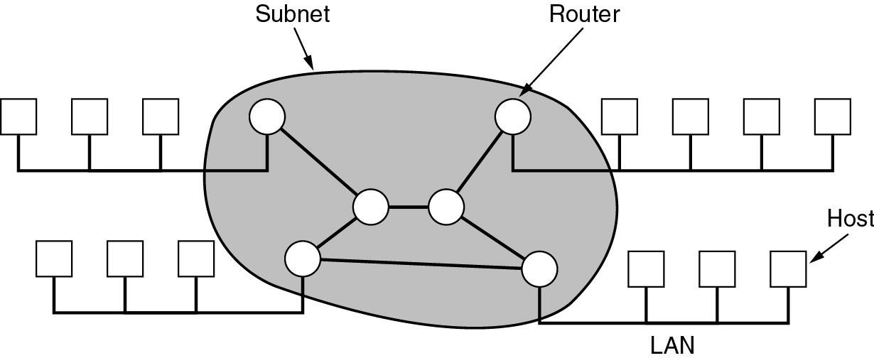
Wide Area Networks (WANs)
WANs are point-to-point networks
WANs consist of two distinct components:
transmission lines (copper, fiber, microwave) and switches (electronics, optics)
⇨ Store-and-forward or packet-switched subnet
Relation between hosts on LANs and the subnet.
52

Slide 24
History of Networking
1969: ARPANET
1970’s: ALOHA, Ethernet, DECNet, SNA
1980’s: Proliferation of LAN (Ethernet, Token Ring)
1987: High speed LAN/MAN (FDDI), BISDN (ATM)
1990: High speed WAN (NSFNET, 45 Mbps)
1993: High speed Ethernet (Fast Ethernet, EtherSwitch)
1996: Interent II (622Mbps)
1998: Gigabit Ethernet
53

Slide 25
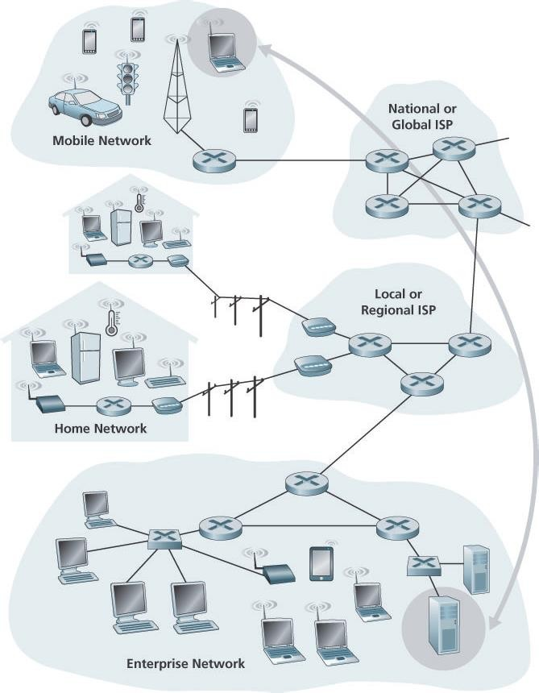
A closer look at network structure
The Network Edge
Access Networks
Physical Media
The Network Core
Packet Switching
Circuit Switching
A Network of Networks

Slide 26
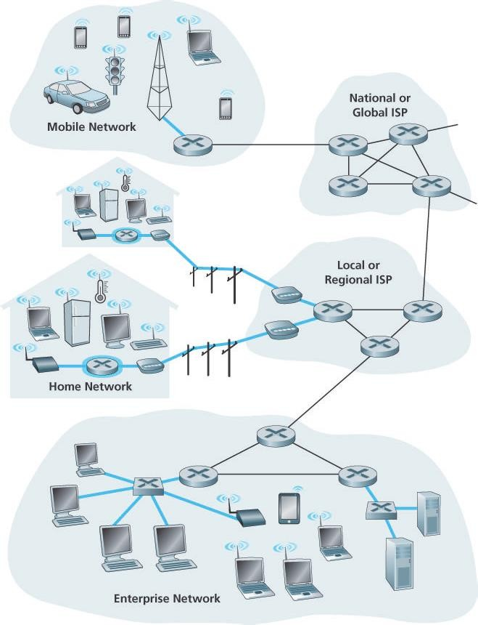
Access Networks
Access networks—the network that physically connects an end system to the first router (also known as the “edge router”) on a path from the end system to any other distant end system
Fig Shows several types of accessnetworks with thick, shaded lines and the settings (home, enterprise, and wide- area mobile wireless) in which they are used.
Digital subscriber line (DSL)
Cable Internet access
Access in the Enterprise (and the Home): Ethernet and WiFi
Wide-Area Wireless Access: 3G 4G and LTE

Slide 27
How homes connect to the Internet
Two most prevalent types of broadband residential access are
Digital subscriber line (DSL)
Cable Access.
residence typically obtains DSL Internet access from the same local telephone company (telco) that provides its wired
local phone access
each customer’s DSL modem uses the existing telephone line
The residential telephone line carries both data and traditional telephone signals simultaneously, which
are encoded at different frequencies:
A high-speed downstream channel, in the 50 kHz to 1 MHz band
A medium-speed upstream channel, in the 4 kHz to 50 kHz band
An ordinary two-way telephone channel, in the 0 to 4 kHz band
This approach makes the single DSL link appear as if there were three separate links, so that a telephone call and an
Internet connection can share the DSL link at the same time

Slide 28
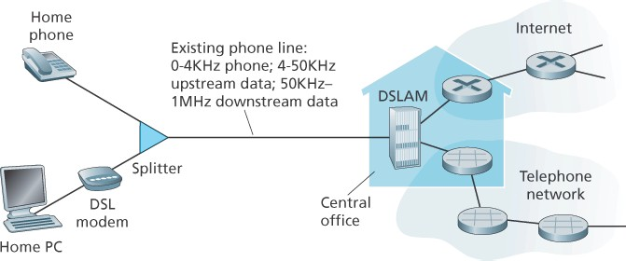
Digital subscriber line (DSL) Internet access
use existing telephone line to central office DSLAM
data over DSL phone line
goes to Internet
voice over DSL phone line goes to telephone net
< 2.5 Mbps upstream transmission rate (typically < 1 Mbps)
< 24 Mbps downstream transmission rate (typically < 10 Mbps)
On the customer side, a splitter separates the data and telephone signals arriving to the home and forwards the data signal to the DSL modem.
On the telco side, in the CO, the DSLAM separates the data and phone signals and sends the data into
the Internet
The DSLAM equipment collects the data from its many modem ports and aggregates their voice and data
traffic into one complex composite "signal" via multiplexing.

Slide 29
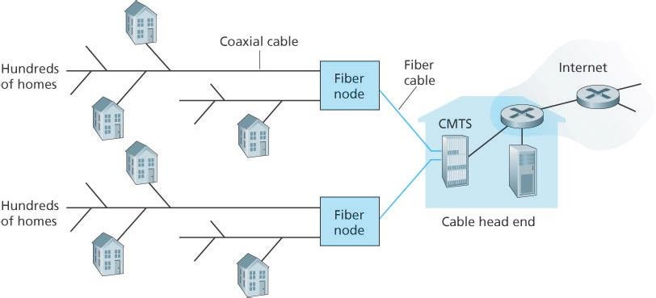
Cable Internet access
Makes use of the cable television company’s existing cable television infrastructure.
A residence obtains Cable Internet access from the same company that provides its cable television.
an up-and-coming technology that provides even higher speeds is fiber to
the home (FTTH):provide an optical fiber path from the CO directly to the home: Gibabits/s range
Fiber optics connect the cable head end to neighborhood-level junctions, from which traditional coaxial cable is then used to reach individual houses and apartments. Each neighborhood junction typically supports 500 to 5,000 homes. Because both fiber and coaxial cable are employed in this
system, it is often referred to as hybrid fiber coax (HFC).
it is a shared broadcast medium

Slide 30


















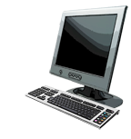







Access in the Enterprise (and the Home): Ethernet and WiFi
institutional link to ISP (Internet)
institutional router
Ethernet
switch
institutional mail,
web servers
On corporate and university campuses, and increasingly in home settings, a local area network (LAN) is
used to connect an end system to the edge router: Ethernet LAN is the most prevalent access technology
typically used in companies, universities, etc.
10 Mbps, 100Mbps, 1Gbps, 10Gbps transmission rates
today, end systems typically connect into Ethernet switch
Introduction
1-59

Slide 31
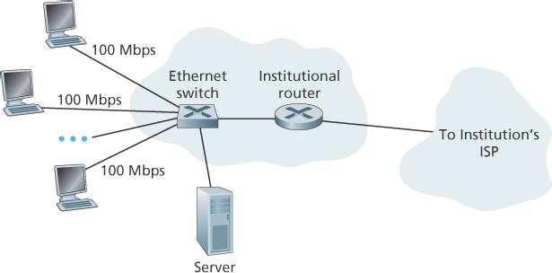
Access in the Enterprise : Ethernet and WiFi
Ethernet Internet access
Ethernet users use twisted-pair copper wire to connect to an Ethernet
switch, technology
The Ethernet switch, or a network of such interconnected switches, is then in turn connected into the larger Internet
Users have 100 Mbps or 1 Gbps access to the Ethernet switch, whereas
servers may have 1 Gbps or even 10 Gbps access

Slide 32
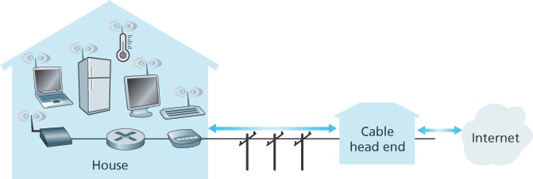
Typical Home Network
This home network consists of a roaming laptop as well as a wired PC; a base station (the wireless access point), which communicates with the wireless PC and other wireless devices in the home;
a cable modem, providing broadband access to the Internet; and a router, which interconnects the base station and the stationary PC with the cable modem
Many homes combine broadband residential access (that is, cable modems or DSL) with these inexpensive wireless LAN technologies to create powerful home networks

Slide 33
Wide-Area Wireless Access: 3G 4G and LTE
Wireless infrastructure used for cellular telephony to send/receive packets through a base station that is
operated by the cellular network provider.
iPhones and Android devices are being used to message, share photos in social networks, watch movies, and stream music while on the run
Unlike WiFi, a user need only be within a few tens of kilometers of the base station.
The fourth-generation (4G) of wide-area wireless networks—are already being deployed pretty much
everywhere.
LTE (for “Long-Term Evolution has its roots in 3G technology, and can achieve rates in excess of 10 Mbps.
LTE downstream rates of many tens of Mbps have been reported in commercial deployments
Difference between them is the speed of the network.
When selecting a smartphone, the older models may not support the newer data network technology. It is important to select a model that supports a data speed appropriate for your needs.
Generation of network technology: The third generation network, known as 3G, is the oldest technology of the group. 4G is the fourth generation data network and LTE stands for Long Term Evolution.

Slide 34





